Slide 1
We are going to have a quiz over demand next class so let’s review.
Get a Whiteboard and a Dry Erase Maker so we can Practice.

Slide 2
Using your whiteboard, draw the following:
Draw the demand curve for Coca-cola the market.
Show what will happen to the market if Coke goes on sale.
Show what will happen to the market today if Coke is advertised to go on sale nest week.
Show what will happen to the market if Pepsi (a likely substitute) goes on sale.
What is another factor that could cause the demand curve to shift to the left?
How about to the right?

Slide 3
Suppose some new company has started making a new gadget called a widget.
Show the market for widgets.
In order for people to use widgets, they must also own a gizmo. What is this relationship called?
Now suppose this new company has made some bad financial decisions that have caused the price of widgets to skyrocket. Show this effect on your graph.
Now show what the effect will be on the market for gizmos.

Slide 4
Think of two different goods - one that is likely to be a normal good and one that is probably an inferior good.
What is the difference?
Graph the market for each of your goods.
Now imagine some small town that recently realized it had massive gold reserves beneath it. Nearly everyone has become much, much richer.
What will be the effect on the market for each of your goods?

Slide 5
Let’s do one more.
Graph the market for hybrid cars 10 years ago.
Now show how the demand has changed today.
What explains this change?
Now reflect those changes in the market for gasoline (is it a complement or a substitute?)
If the general quantity of gas demanded stays about the same, what will happen to the price?
Is that what was see happening today?

Slide 6
Elasticity of Demand

Slide 7
Elasticity
First let’s think about gasoline vs. movie tickets.
If the price doubles are you still likely to buy it?
Elasticity measures how responsive consumers are to price changes.
A good is elastic, if quantity demanded changes significantly as price changes.
A good is inelastic, if quantity demanded changes little as price changes.

Slide 8
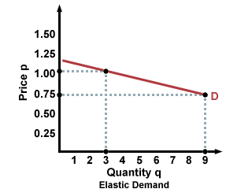
Elastic Goods – the curve is flatter

Slide 9
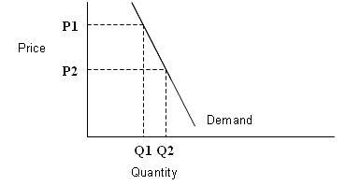
Inelastic Goods – the curve is steeper

Slide 10
What can you think of that is…
Elastic
Inelastic
Airline Flights
Popcorn
Flat Screen TVs
Apps on Cellphones
Gasoline
Medical Expenses
Baby Formula
Tires

Slide 11
Determinants of Elasticity

Slide 12
Substitute Goods or Services
If there is no substitute for a good, demand tends to be inelastic.
Insulin vs. Beef

Slide 13
Proportion of Income
The percentage of your income you spend on something can determine elasticity.
Photography vs. Pencils

Slide 14
Necessities vs Luxuries
If something is a necessity, demand tends to be inelastic.
Food vs. Name Brand Clothing

Slide 15
Estimating Elasticity
 | Table Salt | Ice Cream | Sports Car | Gasoline | Insulin | Braces on Teeth
Are there good substitutes?
What proportion of income does it use?
Is it a necessity or a luxury?
Conclusion
NO
YES
YES
NO
NO
NO
SMALL
SMALL
LARGE
SMALL
SMALL
LARGE
NECESSITY
LUXURY
LUXURY
NECESSITY
NECESSITY
LUXURY
INELASTIC
ELASTIC
ELASTIC
INELASTIC
INELASTIC
ELASTIC

Slide 16
Total Revenue Test
Another way you can evaluate demand is through the total revenue test.
Total Revenue (TR) is defined as price (P) times quantity (Q).
TR = P x R
If the Price drops and Total Revenue increases, then demand is elastic.
Elastic = P↓, TR↑
If the Price drops and Total Revenue decreases, then demand is inelastic.
Inelastic = P↓, TR↓

Slide 17
It might help to think about it like this…
Our original price was $1.00
Our TR was $3 (1 x 3)
But then we dropped the price to $.75
Our TR was $6.75 (.75 x 9)
Because the TR went up when the price went down, we know this good is elastic.

Slide 18
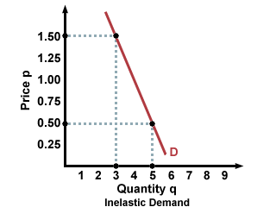
It might help to think about it like this…
Our original price was $1.50
Our TR was $4.50 (1.50 x 3)
But then we dropped the price to $.50
Our TR was $2.50 (.50 x 5)
Because the TR went down when the price went down, we know this good is inelastic.

Slide 19
So in summary…
Elasticity is a measure of how much quantity demanded changes as price changes.
If the price changes, and the quantity demanded changes a lot, the good is elastic. (much flatter slope)
If the price changes, and the quantity demanded changes very little, the good is inelastic. (much steeper slope)
There are three main things that can affect elasticity:
Substitute Goods or Services
Percentage of Income
Luxury vs. Necessity

Slide 20
Let’s just make sure you understand…
Are the following products likely to be elastic or inelastic?
Gallon of milk
Tickets to the opening Titans game
A new suit
A child car seat
Ramen Noodles
Ice Cream

Slide 21
We are going to have a quiz over this next class. Make sure you know the following:
The Law of Demand
How changes in prices affect the quantity demanded of a good.
Other factors that affect demand
Make sure you know and can explain how those factors cause the demand curve to shift
The different between elastic and inelastic goods.
You should also know how to tell whether a good is elastic or inelastic

